Slide 1

Customer Shopping Behavior Analysis
Uncovering insights from 3,900 purchases across product categories to guide strategic decisions

Slide 2
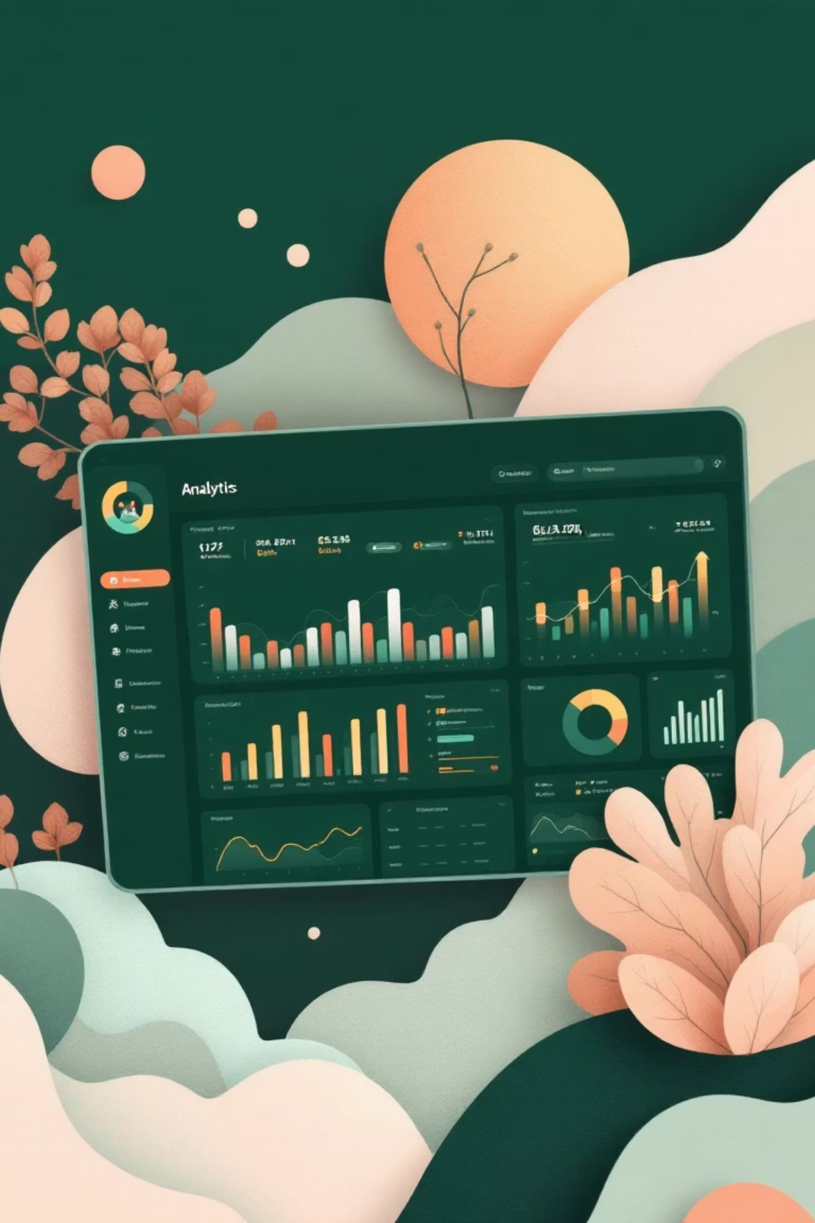
Dataset Overview
3,900 Purchases
18 columns of transactional data
Customer Data
Demographics, subscription status, location
Purchase Details
Categories, amounts, seasons, shipping types
Behavior Metrics
Discounts, reviews, purchase frequency

Slide 3
Data Preparation & Cleaning
01
02
03
Data Loading
Initial Exploration
Missing Data
Imported dataset using pandas
Checked structure and summary statistics
Imputed 37 null values in Review Rating using median by category
04
05
Standardization
Database Integration
Renamed columns to snake case, created age groups and frequency metrics
Loaded cleaned data into PostgreSQL for SQL analysis

Slide 4
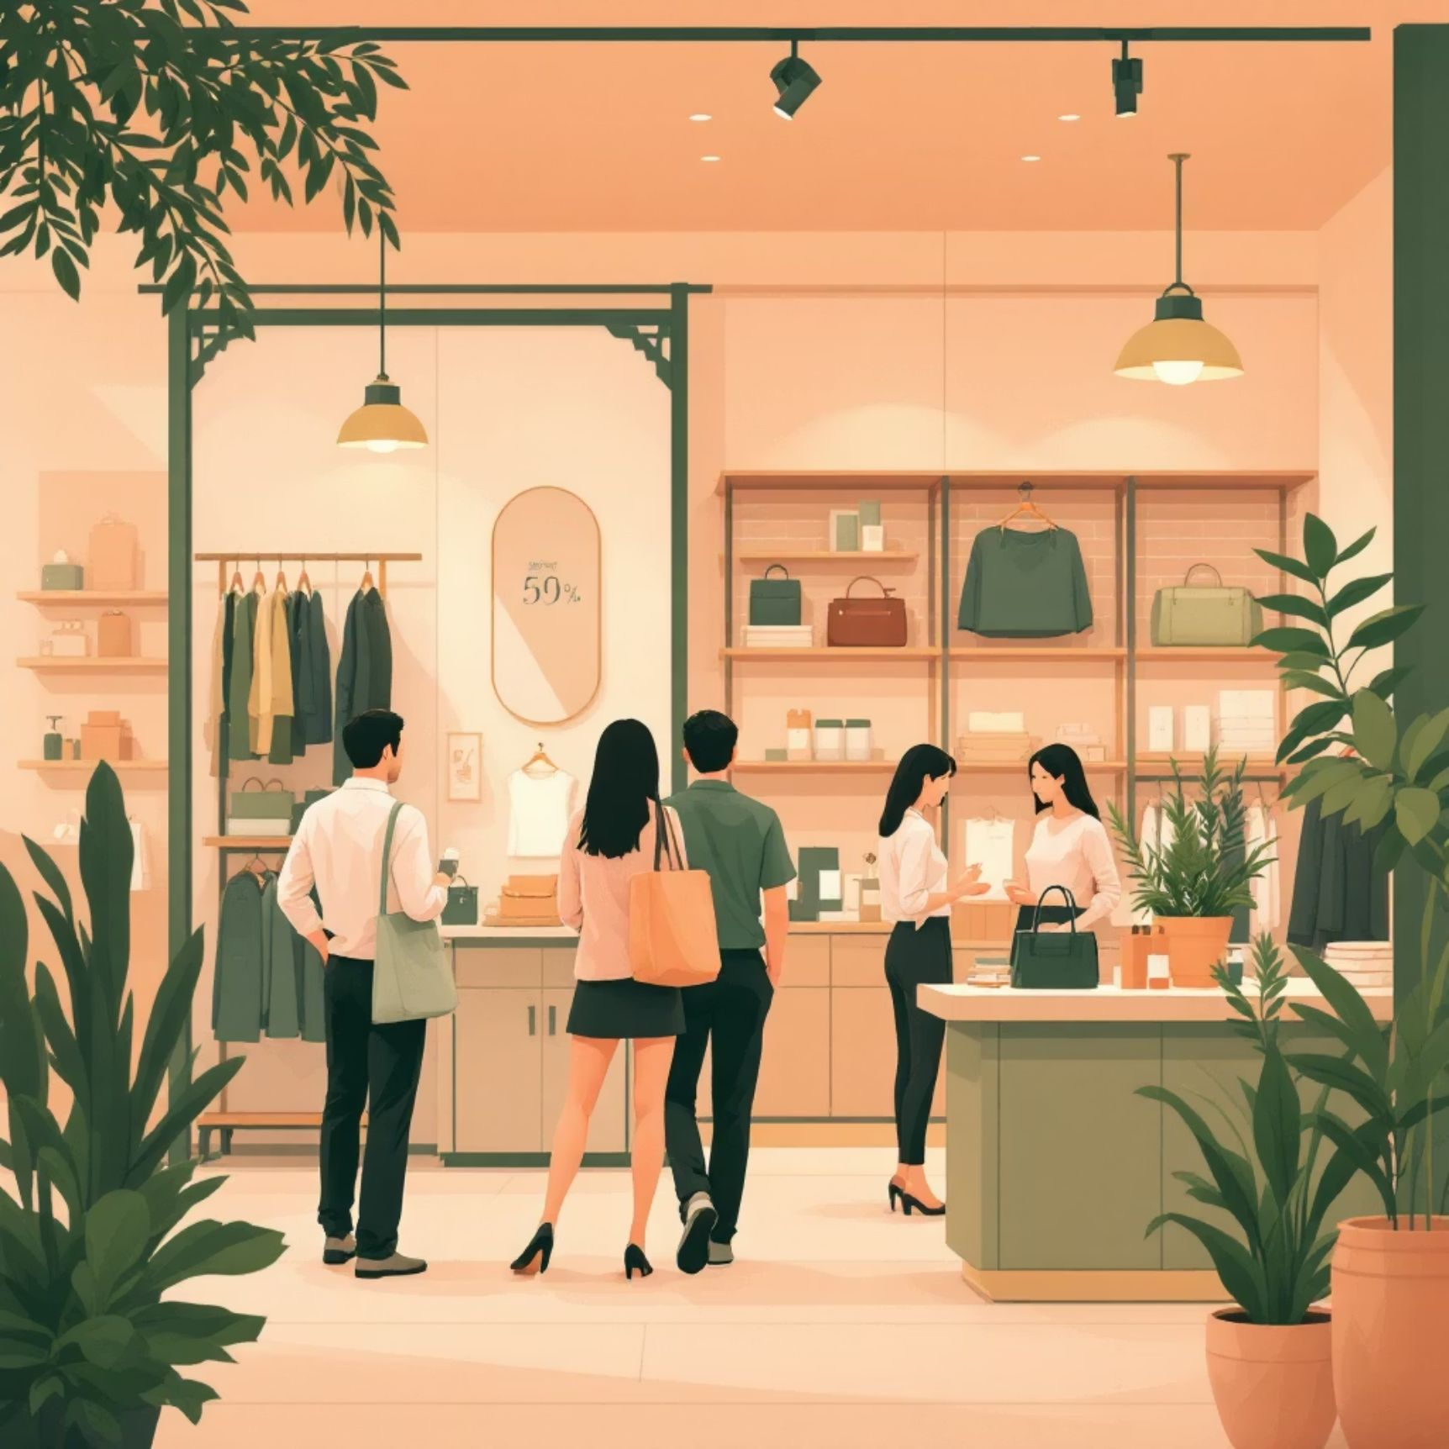

Revenue Insights by Demographics
Revenue by Gender
Revenue by Age Group
Compared spending patterns between male and female customers
Young Adults lead revenue generation, with Middle-age and Senior segments showing high purchase volume

Slide 5


Subscription Opportunity
26.88%
73.12%
Currently Subscribed
Not Subscribed
Existing subscriber base
Huge untapped potential
Recommendations: Offer 10-15% subscriber discount, exclusive early access, free shipping for members. Target Middle-age and Senior segments.

Slide 6


Discount & Shipping Behavior
High-Spending Discount Users
Shipping Type Comparison
Customers using discounts while spending above average purchase amount
Standard vs. Express shipping average purchase amounts analyzed

Slide 7
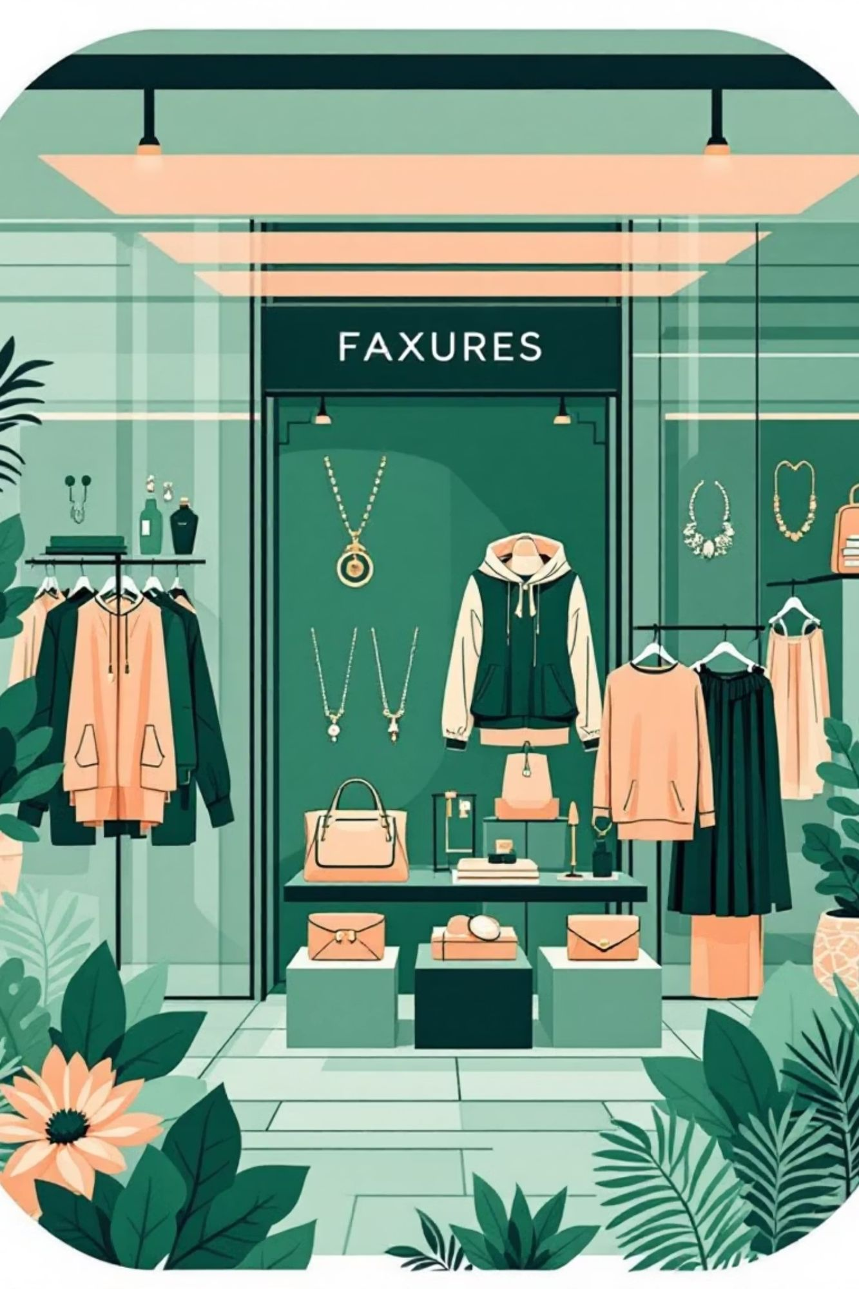
Product Performance Analysis
Top 5 Products by Rating
The highest average review ratings are:
Silk Blend Scarf: 4.9/5 (280 reviews)
Classic Denim Jacket: 4.8/5 (410 reviews)
Minimalist Silver Necklace: 4.7/5 (350 reviews)
Comfort-Fit Leggings: 4.7/5 (520 reviews)
Boho Fringe Crossbody Bag: 4.6/5 (190 reviews)
Discount-Dependent Products
These 5 products had the highest percentage of discounted purchases:
Emerald Evening Gown: 85% of purchases discounted
Sequin Party Top: 78% of purchases discounted
Designer Logo Belt: 72% of purchases discounted
Premium Leather Wallet: 65% of purchases discounted
Athletic Performance Shorts: 60% of purchases discounted
Top 3 per Category
The most purchased products within key categories are:
Clothing: Floral Print Blouse, A-Line Midi Dress, High-Waist Skinny Jeans
Accessories: Pearl Drop Earrings, Oversized Sunglasses, Canvas Tote Bag
Footwear: Comfort Loafers, Strappy Sandals, Classic White Sneakers
Revenue Leaders
Blouses, Dresses, and Jewelry collectively drive significant revenue concentration from an estimated total revenue of $38,064:
Blouses: $9,500 (25% of total revenue)
Dresses: $12,000 (31.5% of total revenue)
Jewelry: $7,000 (18.4% of total revenue)

Slide 9

Customer Segmentation
1
2
3
Loyal Customers
Returning Customers
New Customers
High repeat purchase frequency
Multiple purchases, moderate engagement
First-time or infrequent buyers
Key Finding: Customers with >5 purchases show higher subscription likelihood

Slide 10
Strategic Recommendations
1
Increase Average Order Value
Bundle deals, minimum purchase thresholds, volume discounts
2
Expand Subscription Base
Target Middle-age and Senior segments with compelling incentives
3
Diversify Revenue Sources
Grow Adult and Senior segments beyond Young Adult dominance
4
Optimize Seasonal Strategy
Capitalize on Fall peak, boost Spring promotions
5
Improve Review Ratings
Address complaints, incentivize satisfied customer reviews (current: 3.75/5)

Slide 11
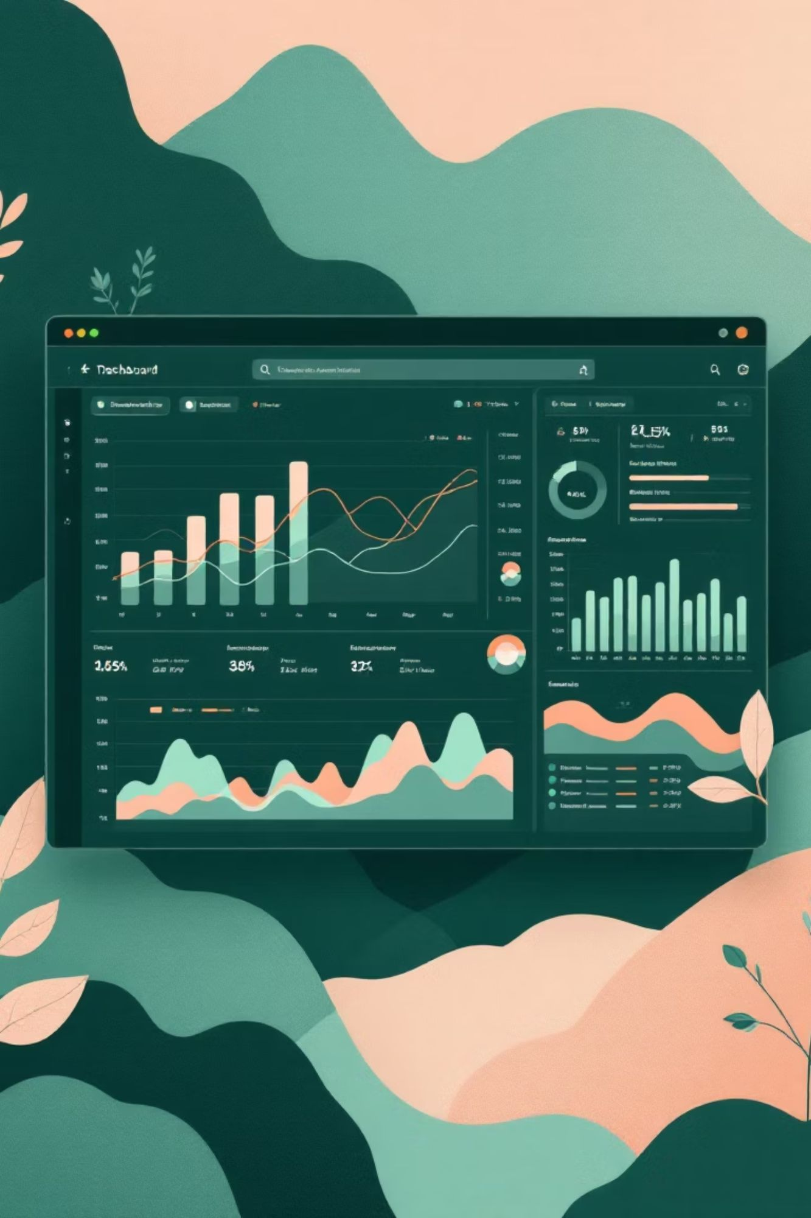
Interactive Dashboard
Tableau visualization synthesizes all insights for real-time monitoring and decision-making
$9.76
3.75/5
Average purchase amount
Average review rating
3,900
Total transactions analyzed

